Slide 1
The Southern Colonies
WALT
Determine the causes and consequences of global issues
WASI
Identify the characteristics of the southern colonies

Slide 2
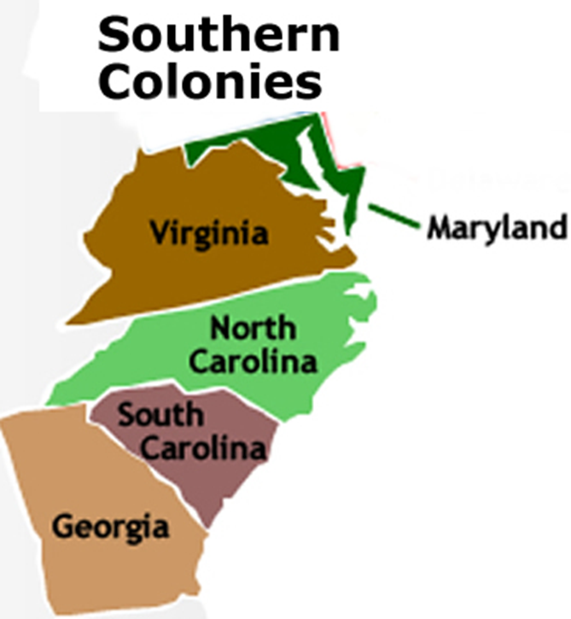
The Southern Colonies

Slide 3
Chesapeake vs. Carolinas
1680’s
  Indentured servants
  Slave society
Late 1600’s-Early 1700’s
  Slaves are the majority!

Slide 4
Slavery
Economic Wealth
  Tobacco
  Rice
  Indigo

Slide 5
Slavery
Field Work
  Women
  Blacks vs. Whites
  Task Society

Slide 6
Moments of stability
African-American culture builds
‘Typical, nuclear family’
  6 to 8 children
  Faithful in marriage

