Slide 1
Removal and assimilation
Native Americans in the USA

Slide 2
Oneida Treaties
WALT
  Use cause/effect argument to show how significant events influenced history
  Explain how and why events are interpreted differently by historians
WASI
  Formulate an opinion with justification as to whether or not the Oneida tribe was forced off of their own land.

Slide 3
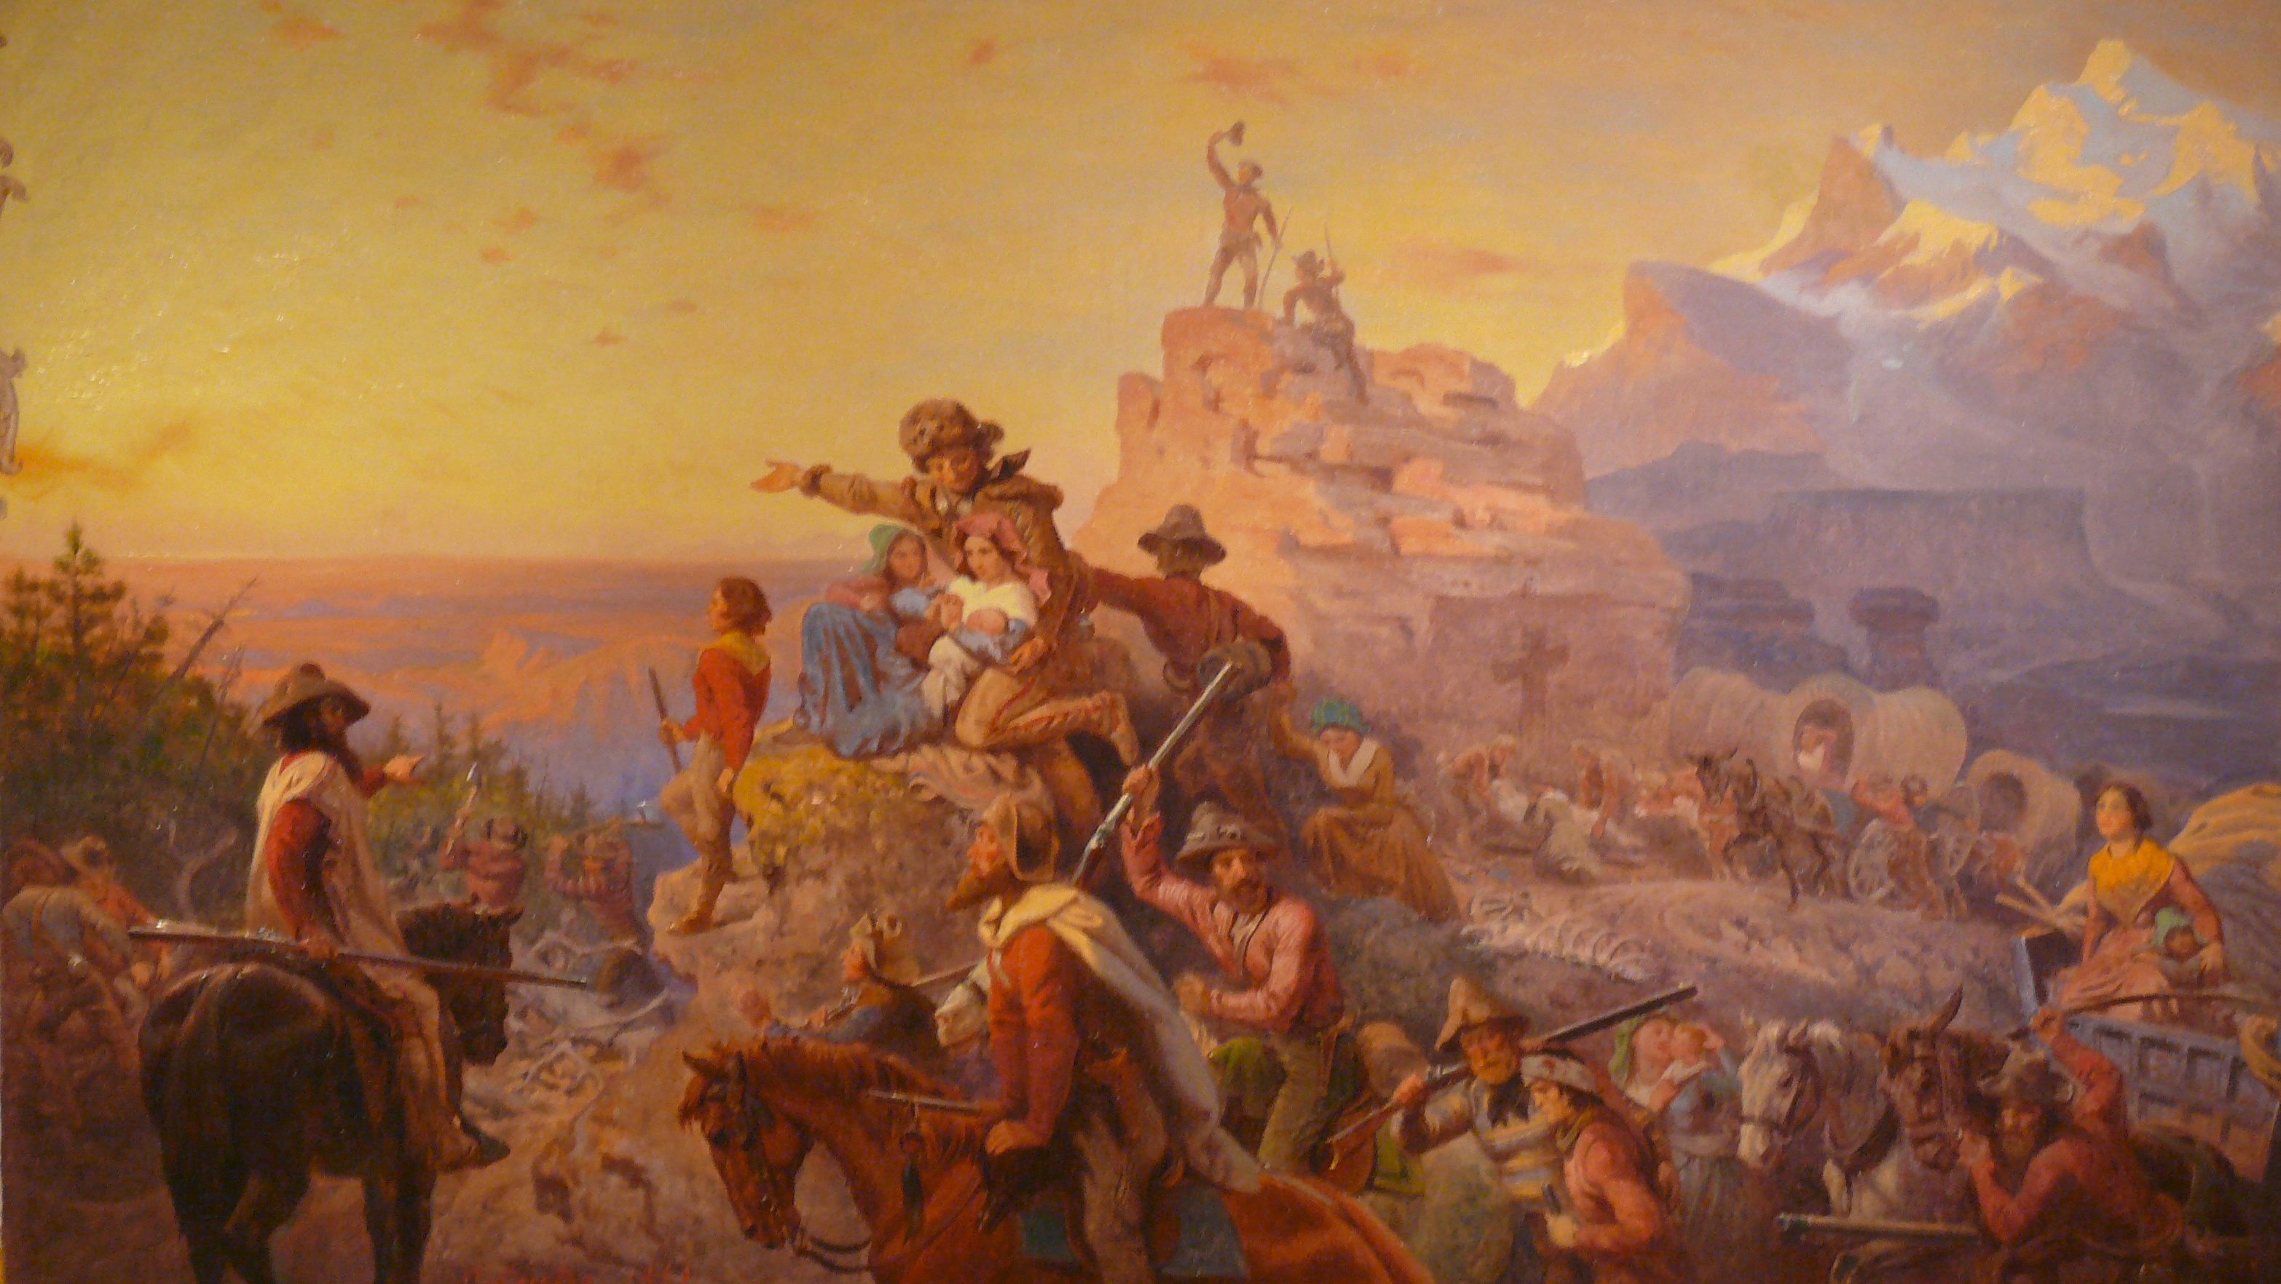

Slide 4
Important terms
United Nations
  (Great Britain and the United States)
Six Nations of the League of the Iroquois
  (Cayuga, Mohawk, Oneida, Onondaga, Seneca and Tuscarora

Slide 5
The Treaty of Fort Stanwix
First treaty between the Oneida and the United States
1784
  Under the Articles of Confederation
Established peace between the United Nations and the Six Nations of the League of the Iroquois
  (Cayuga, Mohawk, Oneida, Onondaga, Seneca and Tuscarora)

Slide 6
The Treaty of Fort Stanwix
During the American Revolution the Oneida and Tuscarora fought alongside the Americans
They were promised that they would retain possession of their lands for their loyalty to the United States

Slide 7
The beginning of LAND CESSION…
  1789
  U.S. and Six Nations reinforced the peace pledge
  NO INDIVIDUAL STATE COULD MAKE TREATIES

Slide 8
The beginning of LAND CESSION…
  Ended any claims the Six Nations had to the Ohio River valley
  In exchange, they received $3000 worth of gifts

Slide 9
New York New York
New York State had a rapidly increasing population
They were running out of room!
Purchased one hundred square miles from the Oneida in 1785

Slide 10
Deception and Lies
The federal government declared the treaties illegal
  State Government > Federal Government
  Unable to hold the state accountable for its actions

Slide 11
Deception and Lies
New York continued to make further land cession treaties with the Oneida
  1805
  1807
  1809

Slide 12
A Land Lost
By the War of 1812, the Oneida had little land left, and many tribal members believed it would be better for the tribe to move west and away from white settlers in New York

Slide 13
Land Cession Map
http://www.slate.com/blogs/the_vault/2014/06/17/interactive_map_loss_of_indian_land.html

Slide 14
Your Turn
Write a paragraph describing your Opinion.
  Were the Oneida tribe was forced off of their own land?
  Use your notes from today to JUSTIFY your opinion.

Slide 15
Native American Assimilation
The process by which a person or persons acquire the social and psychological characteristics of a group.
Cultural assimilation is the process by which a person or a group's language and/or culture come to resemble those of another group

Slide 16
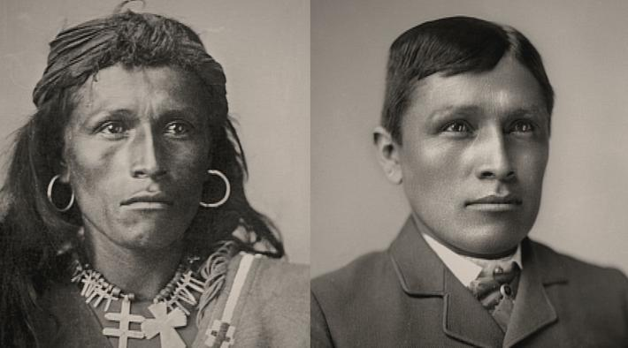
“Kill the Indian, save the man”

